Slide 1
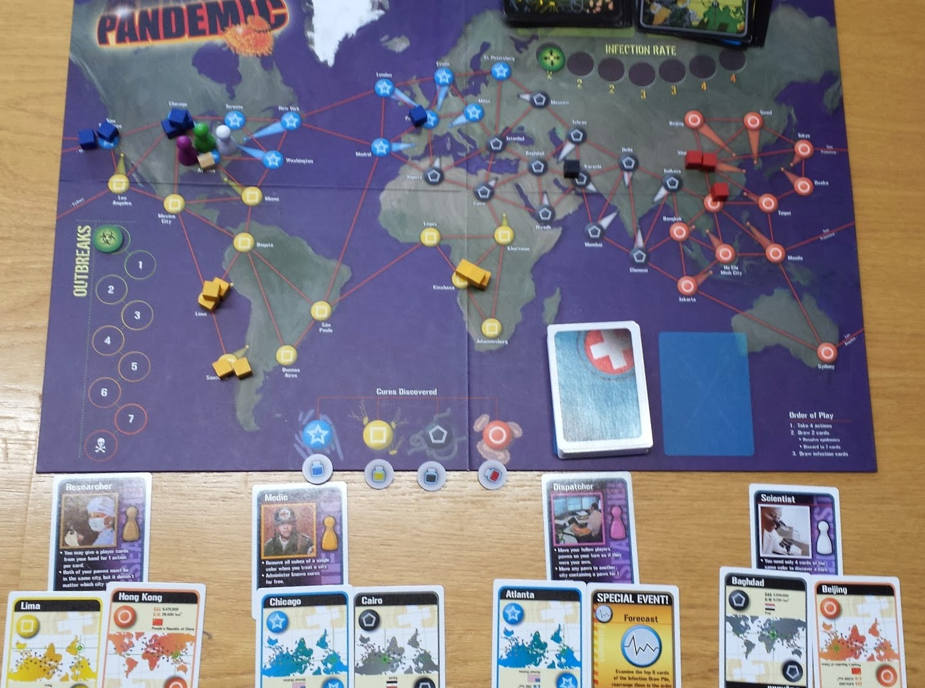
Start of Game

Slide 2
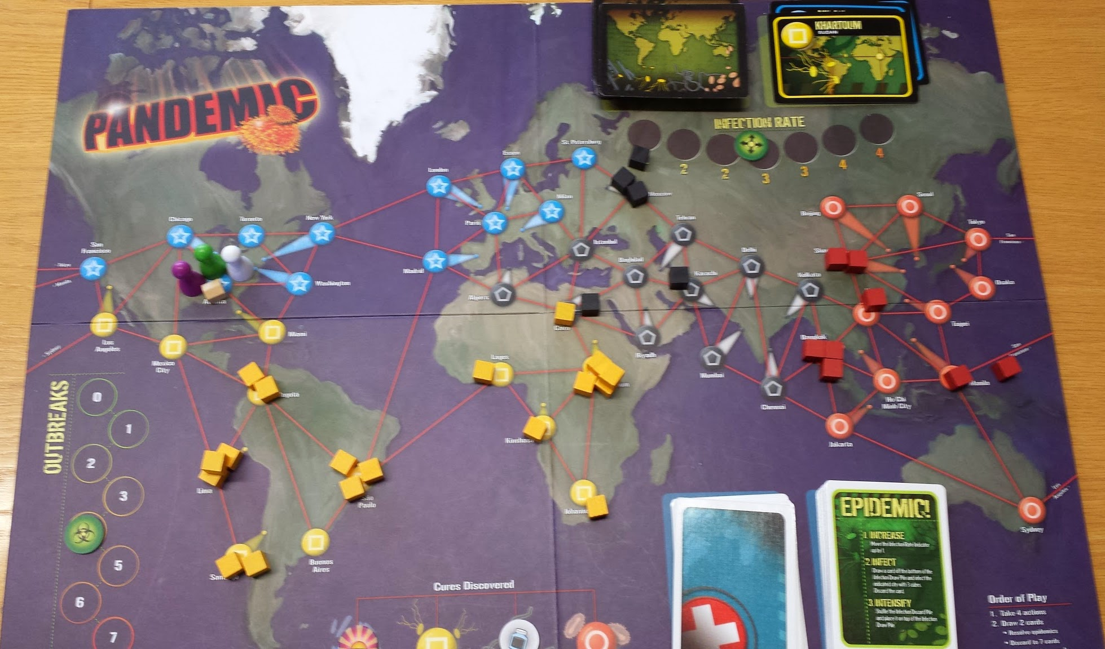
Mid-game display example

Slide 3
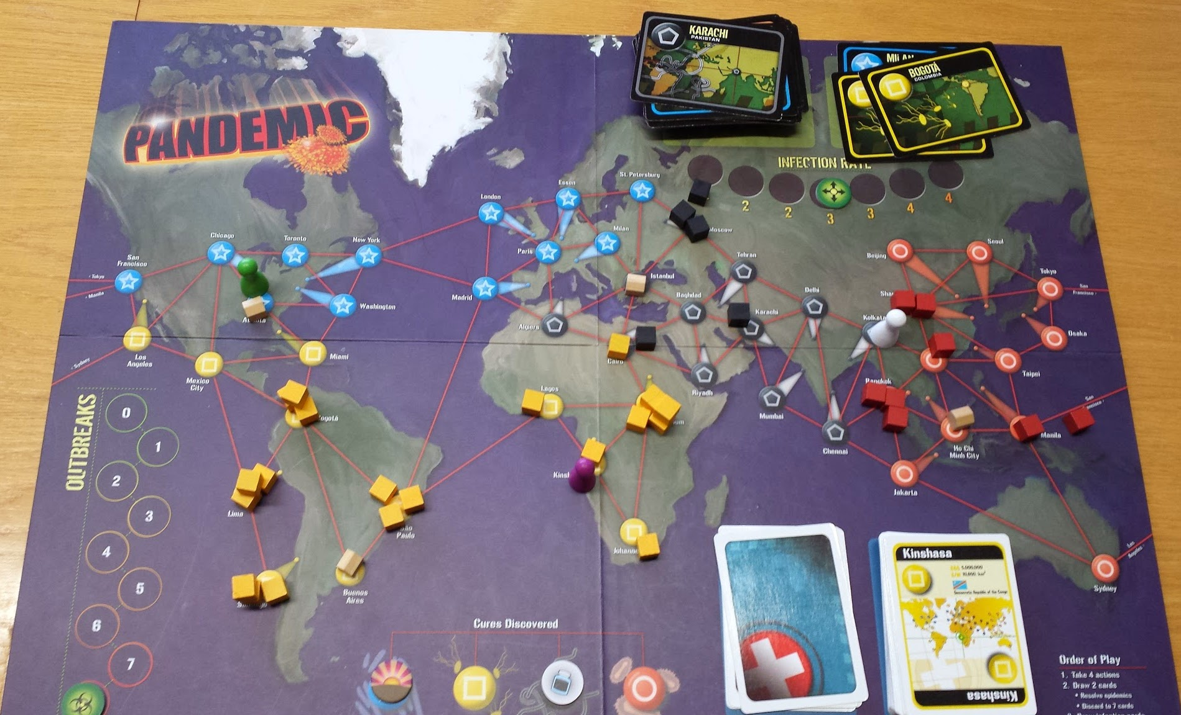
Mid-game display example (2)

Slide 4
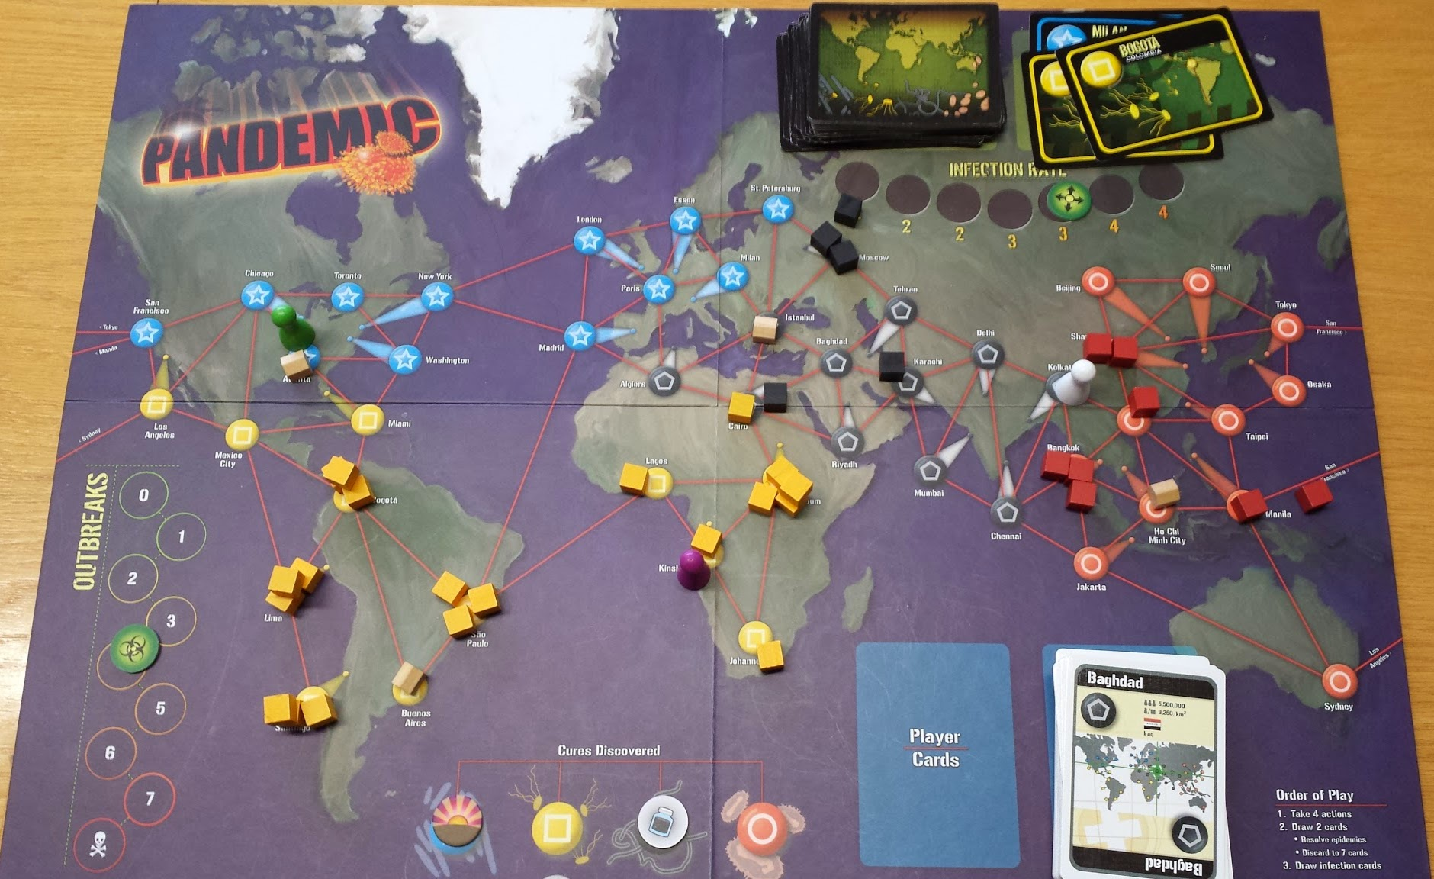
End-game display example

Slide 5
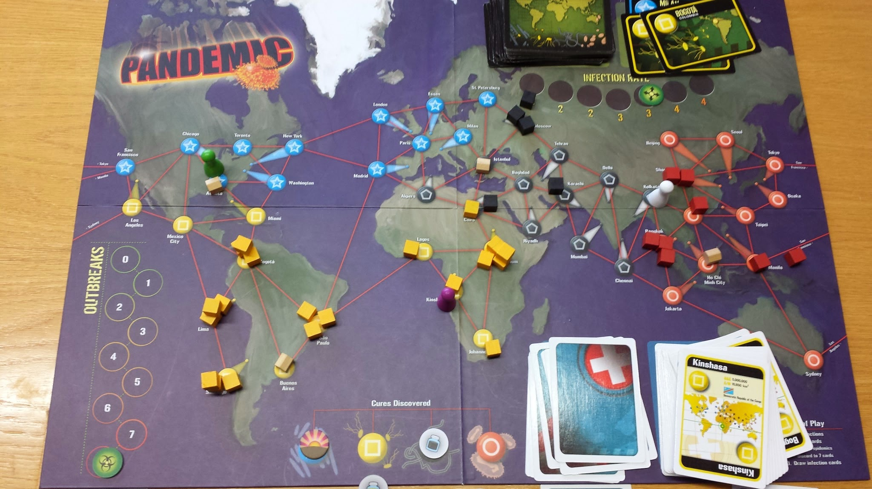
End-game display example (2)

Slide 6
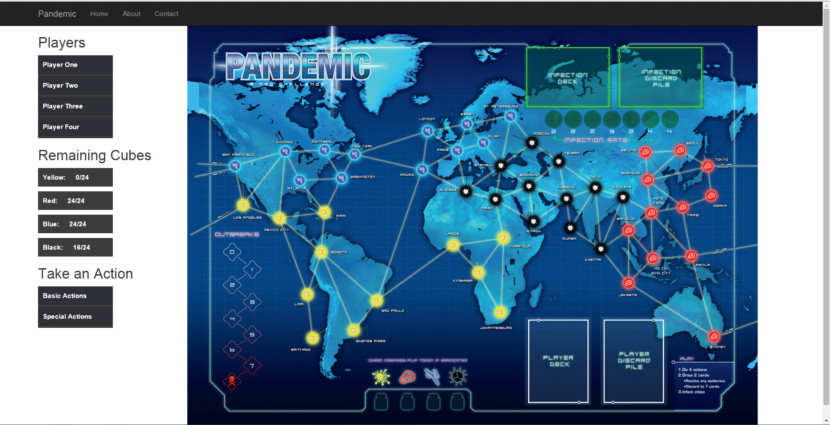
[3/27/2015 10:59 AM] Doolan, Steven Richard:
Current GUI Layout

